Slide 1

Week 1 Kits

Slide 2
Kits are essential for this class
This is a hands-on lab class
You’ll be building circuits and measuring their properties and behaviors using your kits and your computer
When (probably not “If”) you need help, you’ll have to seek it out – if you’re shy about asking, then you’ll have to allocate additional time for your own exploration and self-discovery
Where to get help?
Each other – you can use the chat to exchange some emails or servers …
Canvas – links to videos, reviewing lecture, …
Trent Ruiz, Max Seligman, other faculty, tutoring center, etc.
Email me …

Slide 3
Link to Canvas docs and videos about the kits

Slide 4
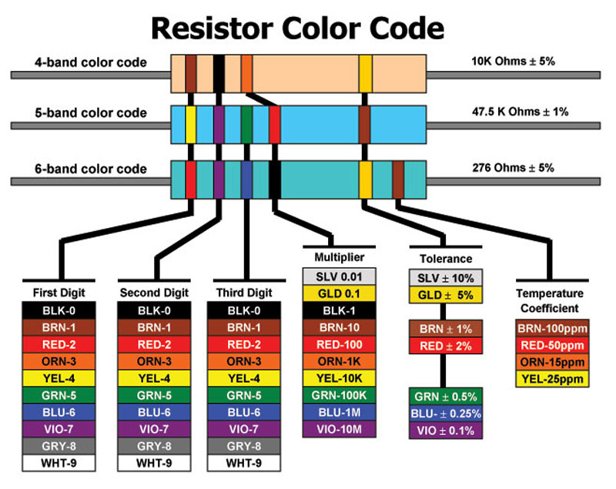
Resistors
Resistors oppose current flow
Resistors convert current to voltage
Series resistors are voltage dividers
Parallel resistors are current dividers
Small resistors from 0.1Ω to 10MΩ are close to ideal (for reasonable voltages, currents, etc.)
Ohm’s Law: V= IR
Watt’s Law: P = VI

Slide 5
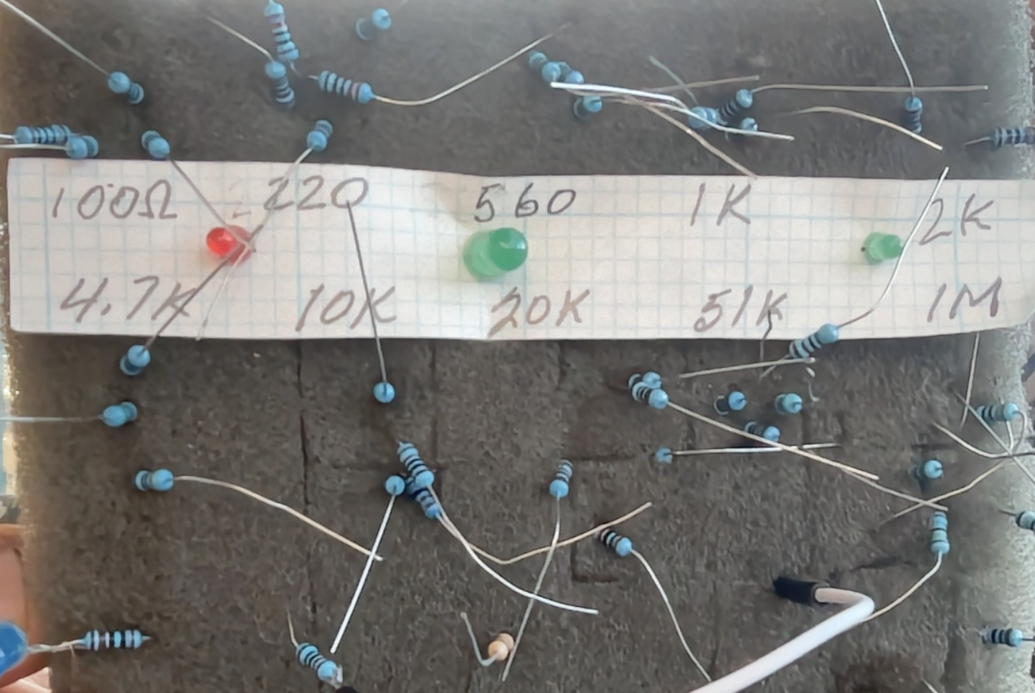
Practical Resistors
Resistors tend to be the most common component we use
Misplacing a 100Ω resistor with a 10kΩ or 100kΩ generally radically changes circuit behavior … and is a challenge to debug
My eyes aren’t good enough to read color codes of these cheap blue resistors
I keep my resistors sorted in a piece of foam
I measure them before replacing them in the foam
I encourage you to make this useful tool or a more convenient one
Foam beats an egg carton when it falls to the floor

Slide 6
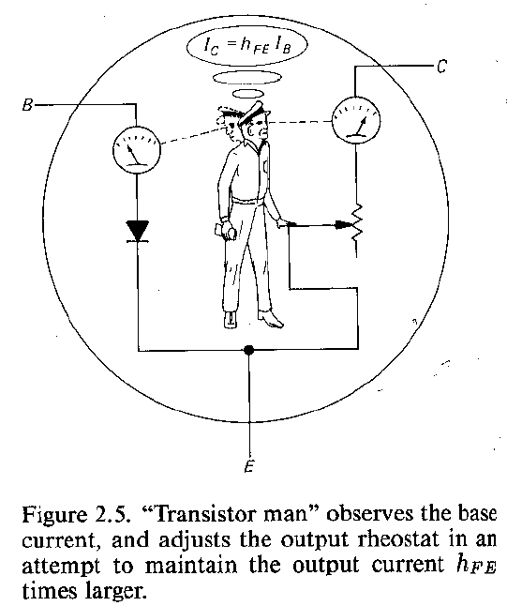
Generalized Resistors
The resistor abstraction is ubiquitous
E.g., transistor model (Art of Electronics, AoE Fig. 2.5)
Saturation
Linear
Cutoff
This theory is clearly wrong – transistors don’t have men in them! They are filled with smoke, because after the smoke comes out of them, they don’t function anymore …

Slide 7
I-V curves
In a circuit (loop), voltage pushes (pulls??) current and the relationship between those is characteristic of the circuit.
Voltage and current are often proportional, i.e., V α I, and we conventionally write, V = IR, i.e., Ohm’s Law and characterize the circuit as resistive when R is constant
We conventionally plot I vs. V, so the slope of such an “I-V curve” is 1/R
Many interesting electronic devices have non-linear I-V curves (which we’ll be measuring and studying)

Slide 8
Wires
Ideal wires have zero resistance and thus V = iR = 0 voltage across them, i.e, they transmit current without loss of voltage, nor loss of power (P = Vi = 0).
Real wires come in many flavors revealing the real trade-offs common in actual devices
http://en.wikipedia.org/wiki/Wire
Stranded vs solid
Big vs. small
http://en.wikipedia.org/wiki/Resistivity
Cu, Au, Ag, Al, NbTi, YBCO, W, …
Insulation and shielding
Power transmission by utilities

Slide 9
Multimeter
Explore a multimeter
Human interface and electric interface to measure:
DC voltage
AC voltage
DC current
AC current
Resistance
Some measure capacitance, inductance, frequency, hfe, etc.
How can you damage one?
Measure voltage on a current scale
Measure voltage or current on a resistance scale
Exceed the ratings
How can one damage you?
Probes are sharp
Bring you closer to potentially dangerous voltages

Slide 10
Multimeter
Rasnow’s rules:
Don’t measure current with a multimeter – always instead measure voltage across a series resistor
Good circuit design includes adding small diagnostic resistors for this purpose
Return the main dial to voltage right after measuring something else – to minimize the chance of accidently measuring a voltage with the meter in Ω or other mode.
Always take a reference measurement that indicates the meter is working. E.g., shorting the leads on a voltage scale → 0V or the “noise floor”. Resistance should be OL with leads open and ~ zero when shorted.
When in doubt, use a different multimeter to verify consistent results (old joke: a physicist with a thermometer knows the temperature, but a physicist with 2 thermometers is never sure)
More expensive meters can save you time and frustration justifying their $$$ after you realize the cheapo meter has been lying to you …

Slide 11
Soldering kit(s)
Soldering kit (https://www.amazon.com/gp/product/B07GJNKQ8W)
Don’t run your soldering iron too hot – it will oxidize and burn up
~350C (660F) is a good temperature (assuming thermostat is calibrated, eutectic solder, low thermal inertia parts … 400C (750F) is significantly hotter
First time you turn it on, cover the tip in solder
You’ll want a ~1mm tip – too sharp → too little area for heat transfer, too big → too much heat flow melts adjacent locations
Alternative soldering kits:
https://www.amazon.com/gp/product/B09DKQPDKB is a much nicer and enjoyable soldering iron for $37. For $100 or more, e.g., https://www.amazon.com/Weller-WE1010NA-Digital-Soldering-Station/dp/B077JDGY1J you get softer cords, and perhaps better reliability and calibration …
Older soldering stations on ebay can be a good bargain

Slide 12
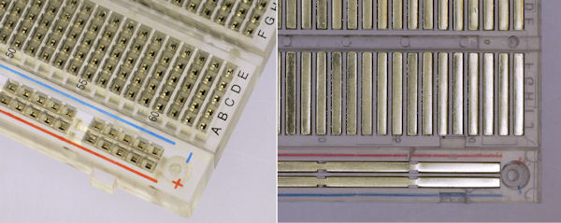
Solderless breadboards
Jamming something too big into the holes can permanently deform the springs (as can heating from excessive current)
Understand which holes are connected … (explore with your ohmmeter)
What happens if you put a component between an A and an E in the same row?
The top and bottom + and – rows are not connected (unless you connect them)

Slide 13
Other stuff in your kits
Develop a discipline to keep track of all the small parts in your kits, because you’ll eventually need them to complete future labs
Keep unused screwdriver tips inside its handle
Return tools to your toolbox after use
Uniquely label your tools before working in groups
…
The boxes in the top of your toolboxes slide out
The “soft skills” of neatness, organization, consideration of others in common workspaces, cleaning up after yourself, …

